Slide 1




History
of Belvoir
www.laganvalleylearning.co.uk

Slide 2
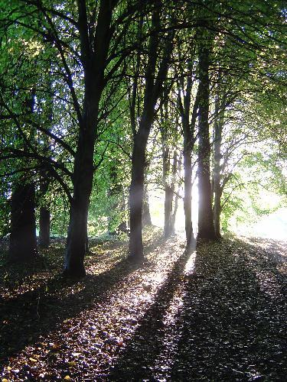

Belvoir Forest
Belvoir Park Forest is a fantastic place for everyone to come and explore but a long time ago it belonged to a rich family, lets have a look…

Slide 3
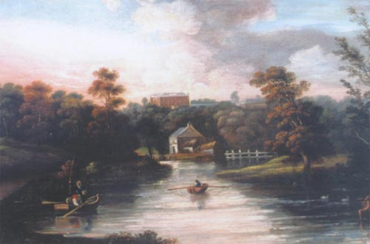
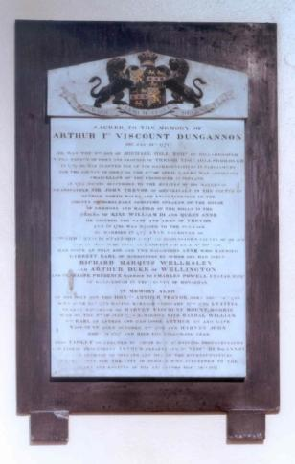
The Hill Family
Belvoir Estate belonged to the Hill family, in the 1740's. Arthur Hill was the daughter of Anne Hill (Lady Middleton) and she wanted to build a house for her son.

Slide 4
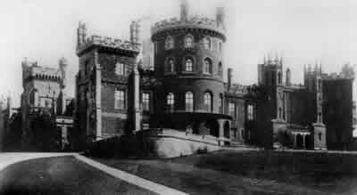
The House’s Name
Work commenced building the house during the 1740s under the instruction of Lady Middleton (Arthur Hill’s mother). She gave the estate the name Belvoir.
Belvoir could mean ‘beautiful view’ – ‘belle voir’ in French
Or she may have called it ‘Belvoir’ because she had spent many happy childhood days at Belvoir Castle, near Grantham in England (see photo above).

Slide 5
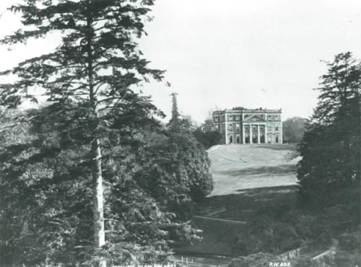
Where was the house?
The house was built where the car park is now.

Slide 6
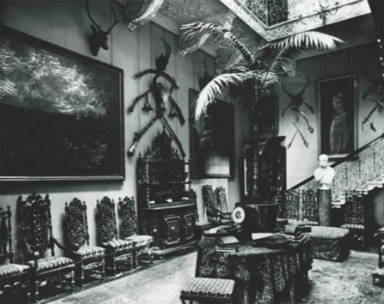
These photos show the original halls and stairway.
What differences are there between this house and your own?

Slide 7
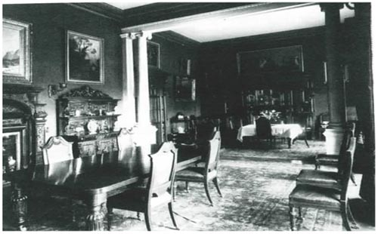
This was where the family and their guests went to relax after they had finished dinner at night.
How do you think they spent their free time?
What do you think they did to relax?

Slide 8
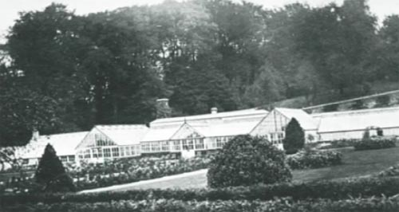
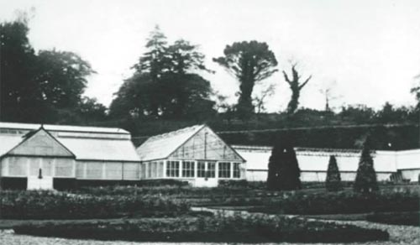
Belvoir Estate would have grown a lot of their own food in greenhouses. It was here that the first glasshouse in Belfast was built in 1757.
What kinds of food would they have grown?

Slide 9


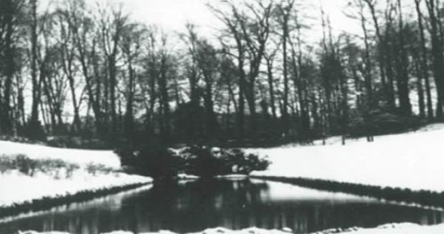
There was also a pond filled with fish, but these were NOT for eating!

Slide 10
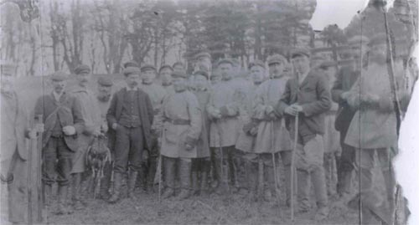
Game keeping
One of the jobs on the Belvoir Estate would have been a game keeper. His job was to look after game birds like pheasants. This picture shows men who have just returned from a day shooting.

Slide 11
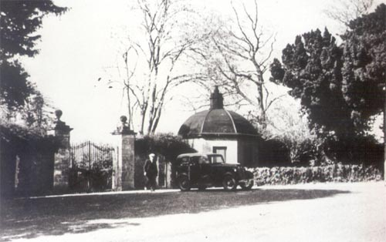
This is the gatehouse to the Belvoir Estate. Why do you think it’s known as “The honey pot”?
The Honey Pot

Slide 12
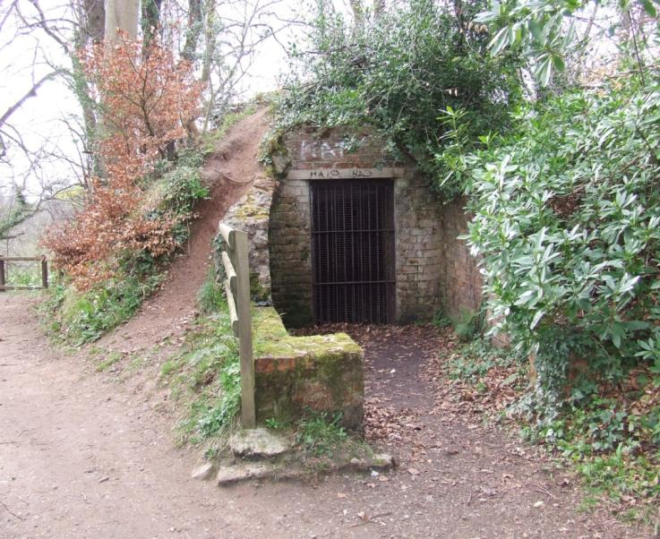
What’s with the ice?
In the 1700s and 1800s people did not have fridges so they had to think of different ways of storing food. Rich people like the Hill family built ice houses which became very fashionable. In Belvoir, when the River Lagan froze, the head gardener and his staff went down to the river and lifted the ice, which they stored here in the ice house.

Slide 13
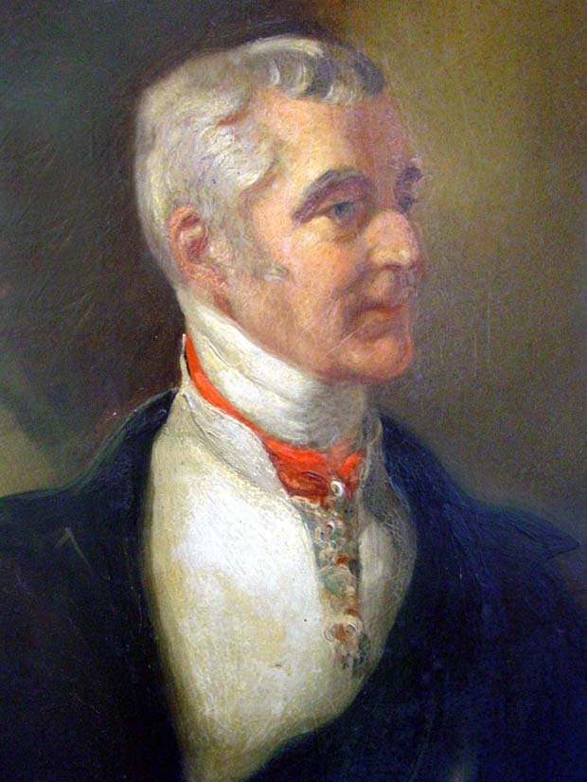
The Duke of Wellington
The famous Duke of Wellington had close links with Belvoir.
His mother was one of Arthur Hill’s daughters.
As a girl she lived in the newly built Belvoir House and later in life at nearby Annadale Hall.
The Duke of Wellington defeated Napoleon at Waterloo in Belgium in June, 1815.

Slide 14
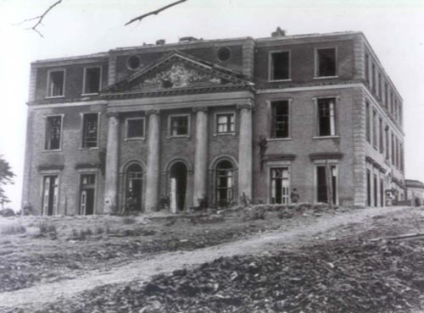
Sold
In 1809 the Hill family sold property to three Belfast merchants.
They sold the ‘Big House’ and Belvoir estate
They also sold all the surrounding land

Slide 15
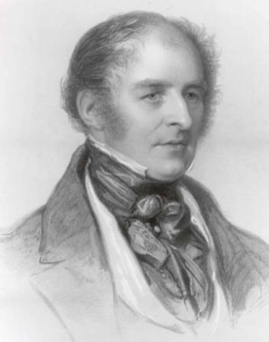
The Batesons
The Batesons came to Ulster from Yorkshire.
One branch of the family established themselves at Orangefield in Belfast in 1815.
Thomas Bateson became the new owner of the Belvoir Estates.

Slide 16
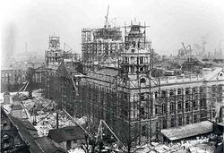
Lord Mayor of Belfast
The last resident was Sir James Johnston who was Lord Mayor of Belfast in 1917 and 1918.
He was married to one of the Gallagher family of the tobacco firm.

Slide 17
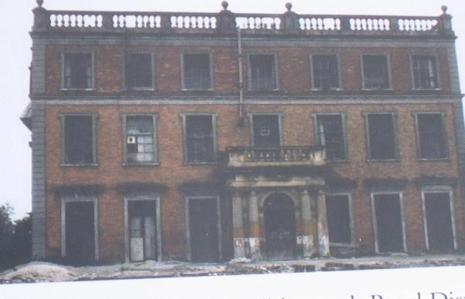
World War II
At the start of World War II the Admiralty took over the estate as a temporary armaments depot.
However in 1955 the Northern Ireland Housing Trust (now the Housing Executive) bought the estate to develop it as a housing project.
After being used during the war, it was very run down…

Slide 18
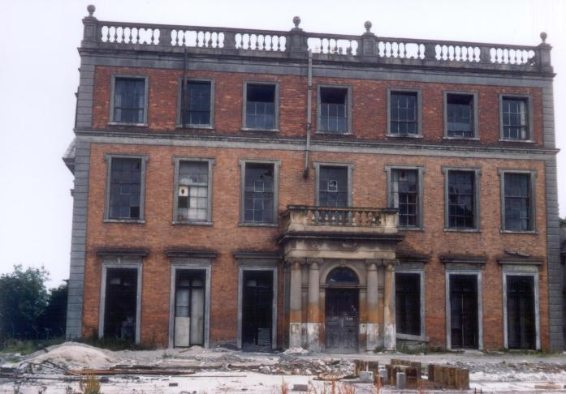
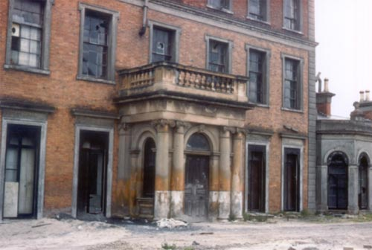

This is how the house looked in the 1960’s.
The rooms in the basement were covered by Disney drawings done by the American soldiers!

Slide 19
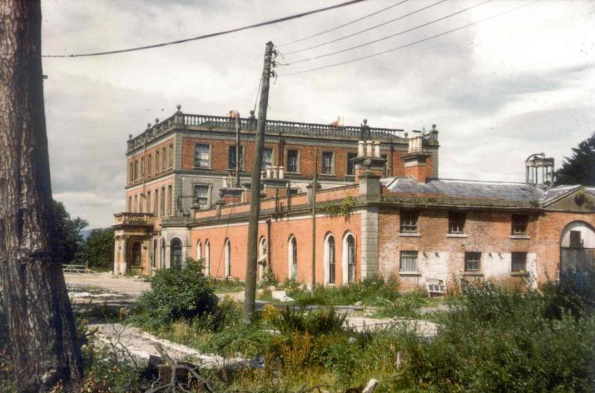
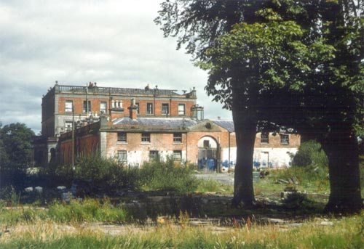
These are some of the last photographs we have of the ‘Big House’.

Slide 20
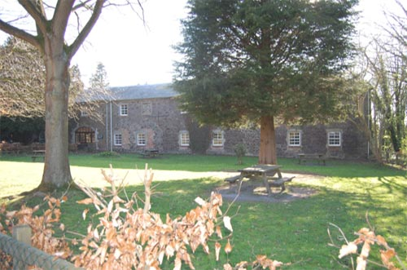
The Stables
The only remaining buildings are the stables that belonged to the estate.

Slide 21
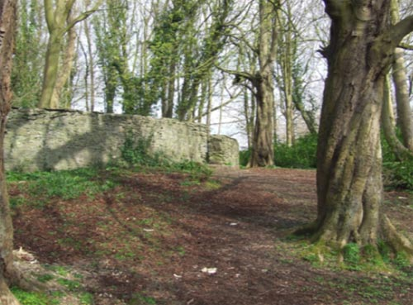
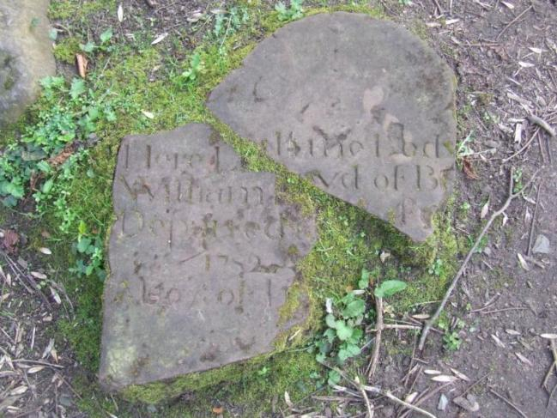
Historic sites in Belvoir
There are a number of historic sites to be found within the forest.
The graveyard, now in ruins, was recorded in 14th century documents.

Slide 22
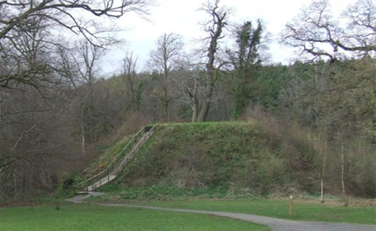
The Normans
This is a Norman Motte which dates back to the 12th century. The Normans built their castles on top of mounds like this so that they could see their enemies coming.
What kind of weapons do you think they would have used to
defend their castles?

Slide 23
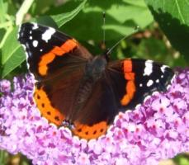
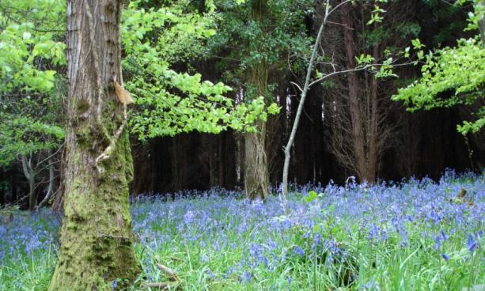
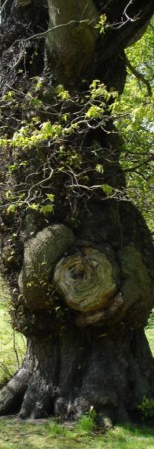
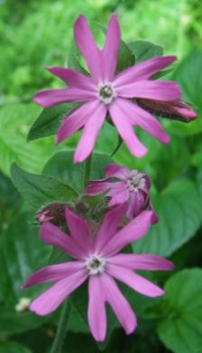
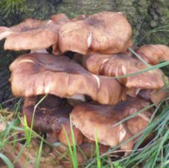
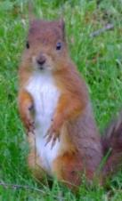
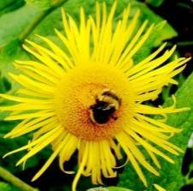
Belvoir Park Forest
The forest Park was opened in 1961 by Forest Service. Now everyone can come and enjoy this beautiful woodland.

Slide 24
www.laganvalleylearning.co.uk

